Slide 1
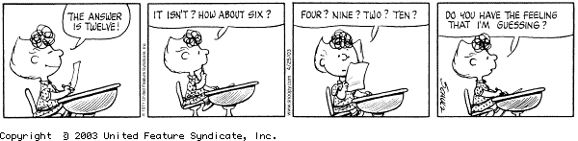
Listing Eligible Women, Children
Interviewers >> Anthropometry forms

Slide 2
Listing Eligible Women, Children
What?
Why?
When?
Who?
How?
Identifying women and children eligible for anthropometry measurement
To ensure all eligible women/children are measured and data properly recorded
After completing household roster interview
Interviewers identify eligible and fill out anthropometry form before measurement
Main interviewer menu, anthropometry forms
Notes:
“identifiers” for the data – meaning who did the interviewers, which teams they are on, which cluster they are in, etc…
Note that if supervisors are acting as interviewers, they should access the interviewer menu

Slide 3
Fieldwork Flow – Anthropometry
Arrive in cluster, Identify households
Interviewers carry out module interviews, collect height/weight
Supervisor assigns households
Interviewers send data to supervisor
Interview HHs, identify eligible individuals
Team resolves structural problems
Interviewer A assigns modules to Interviewer B
Supervisor submits data to central office
Notes:
Quick look at the flow of field work from start to finish in a cluster – training will refer back to this chart regularly

Slide 4




Complete HH roster interview - list eligible women/children
Communicate next steps to HH respondent
Fill out anthropometry forms
Carry out measurement of women/children

Slide 5

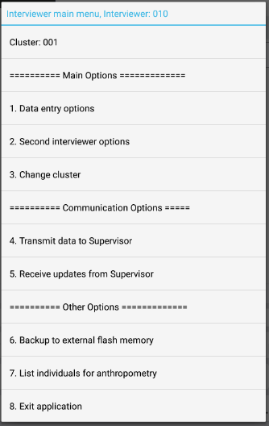
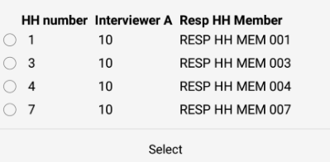
Listing eligible individuals
From interviewer main menu:
Choose correct household to list:

Slide 6
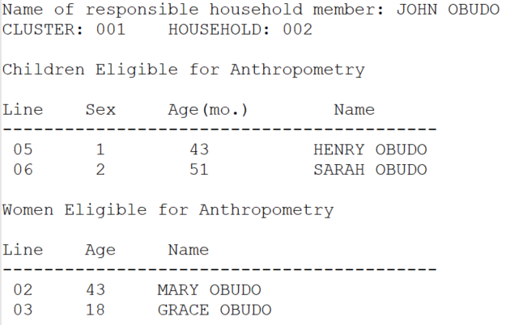
Listing eligible individuals
Household info
Eligible children
Eligible women

Slide 7
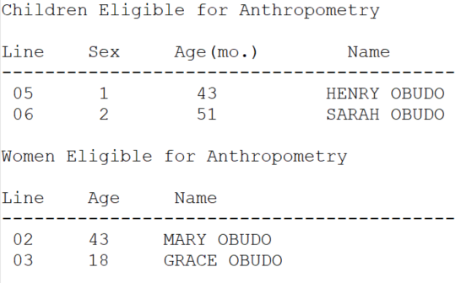

Listing eligible individuals (cont…)
Eligible children
Eligible women
Note: order is children, then women and by line number, NOT age
Notes:
Notice listed by line number, NOT AGE – especially important to notice for children

Slide 8
Communicate next steps
Thank respondent for household interview
Share eligible individuals information with respondent, asking for availability of eligible women and children
Make appointments if needed for measuring eligible women and children

Slide 9
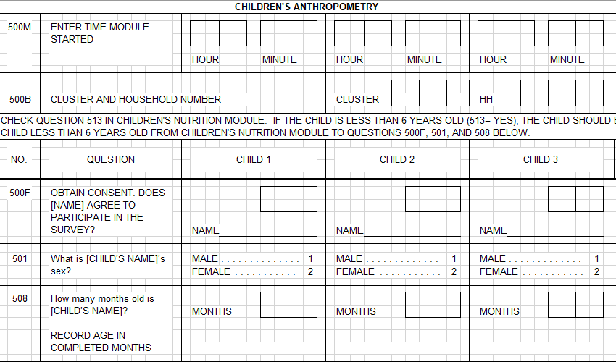
Fill out anthropometry form
Household info
0 0 1
0 0 2
Note: Module start time will be filled when measurement begins

Slide 10
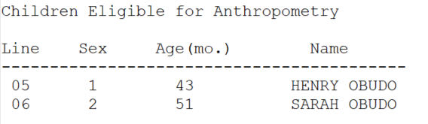
Fill out anthropometry form
Child 1
Child 2
Eligible children
Notes:
Point to each question and ask people what should go in each
Interviewers fill in only 102!

Slide 11
Fill out anthropometry form
Enter in order of line number
Eligible children
0 5
0 6
HENRY
SARAH
4 3
5 1
Notes:
Point to each question and ask people what should go in each

Slide 12
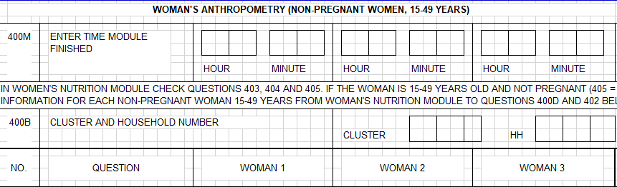
Fill out anthropometry form
Household info
0 0 1
0 0 2
Note: Module start time will be filled when measurement begins

Slide 13
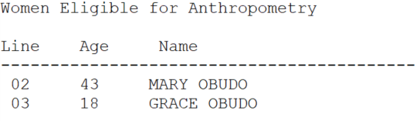
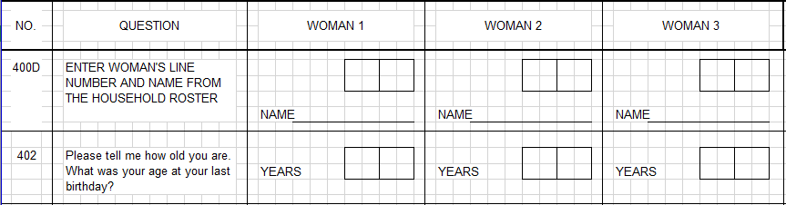
Fill out anthropometry form
Woman 1
Woman 2
Eligible women
Notes:
Point to each question and ask people what should go in each
Interviewers fill in only 102!

Slide 14
Fill out anthropometry form
Enter in order of line number
Eligible women
0 2
0 3
MARY
GRACE
4 3
1 8
Notes:
Point to each question and ask people what should go in each

Slide 15
Why is it important to fill in order of line number?
Notes:
Ask for volunteers!

Slide 16
Why is it important to fill in order of line number?
To ensure all women/ children are measured, CSPro orders records by line number
If paper form is not in order, data entry won’t be in order
If data entry isn’t in order, wrong data will be assigned to the wrong woman/ child!
Notes:
Ask for volunteers!

Slide 17

Time to measure!
Give anthropometry form to interviewers who will measure, and introduce them to the household if needed
… questions?
Notes:
Questions?

